Slide 1
Plan Change 9
Development of Papakāinga Provisions
Notes:
Introuduce yourself
Team has been moving at pase, started early last year, process is much shorter than usual plan change process
Purpose of this presentation is an update to you of where we are at in the process

Slide 2
OUTLINE
FDS & Demand for Papakāinga
Plan Change 9 Purpose and Overview
Previous rule framework prior to recent plan change
How we sought to better enable papakāinga?
The development process
Lessons and learnings?

Slide 3
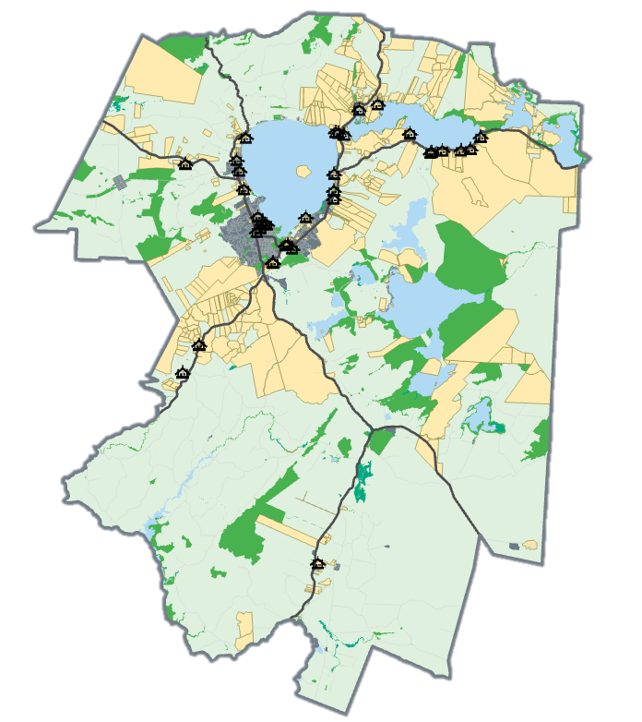
FDS ENGAGEMENT - DEMAND FOR PAPAKĀINGA
Enhance water quality/ restore the awa
Revitalize City Centre
Potential for papakāinga development
Retain heights and character of cultural villages
Investigate opportunities to relocate heavy industry away from Ngapuna
Desire for people to return to Tarawera –support papakāinga development
Council support for servicing rural areas

Slide 4
Purpose of PC9
Plan Change 9 – Housing for Everyone
Enable greater housing supply and choice
Amend current District Plan rules that have been seen as a barrier
Efficient use existing urban environment
Notes:
Greater supply and choice – growing population, idenfitied shortfall, a shift in the types of homes that people wanted to live in.
Shift from 3-4 bedrooms to 1-2 bedrom homes – shortfall for these types of homes.
Barrier to update in the market and smaller types of homes
Focus on the existing urban environment – more effieicent use of infrastructure

Slide 5
Previous rule framework
Operative district plan (2016) considered enabling (by Council planners) for papakāinga development.
Since operative, level of development anticipated had not been realised.
Previous government had urged Council to review papakāinga provisions as part of IPI to incorporate MDRS.

Slide 6
The development process
Engaged support of experienced consultants
Established a Mana Whenua Papakāinga Working group -changes to provisions led by & endorsed by Mana Whenua:
What has worked well?
What hasn’t worked?
Why have we not seen the level of development anticipated?
Develop & workshop issues & options paper
Develop new district plan rules & planning framework
Review & analysis of submissions/further submissions

Slide 7
Enabling Papakāinga
Removing the requirement for Papakāinga to be adjacent to Marae
More enabling density standards (rural)
More enabling for non-residential activities
Notes:
Acknowleding feedbck around barriers for iwi and whanau to develop papakainga
Recognising that papakianga is more than just housing, it can have other activities, such as gathering halls. Broaden up the defintiion of papakainga to accomidate for that
Quick wins for the papakainga provisions to help encourage papakainga on the ground

Slide 8
Lessons and Learnings
Council’s role in enabling papakāinga small part of the puzzle
Critical to have support & endorsement from Mana Whenua.
Acknowledge unique constraints of the district.
Internal & external stakeholders are key to success.
Development of “Rotorua focussed” Papakāinga Toolkit to assist

